Slide 1
KYTC District 6 “Great Eight” Incident Management Task Force
July 9, 2013

Slide 2
Introductions

Slide 3
Approval of Minutes
4/16/13 Meeting

Slide 4
Incident Review
US 62 @ KY 1284 Truck Fire & Fuel Spill
Harrison County 4/24/13
When can KYTC provide assistance?

Slide 5
Incident Review
I-71 NB Truck/Camper Crash 5/2/13
Carroll County MP 38.9
Who is responsible for debris removal?

Slide 6
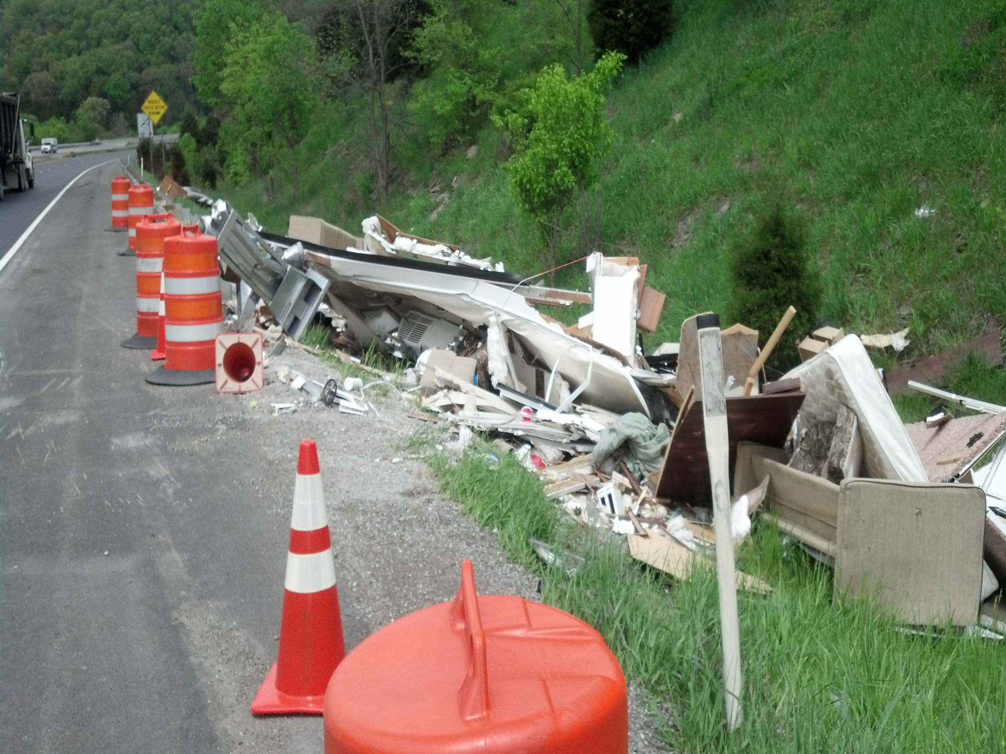

Slide 7
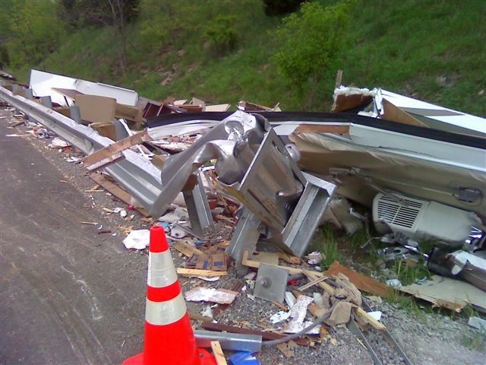

Slide 8
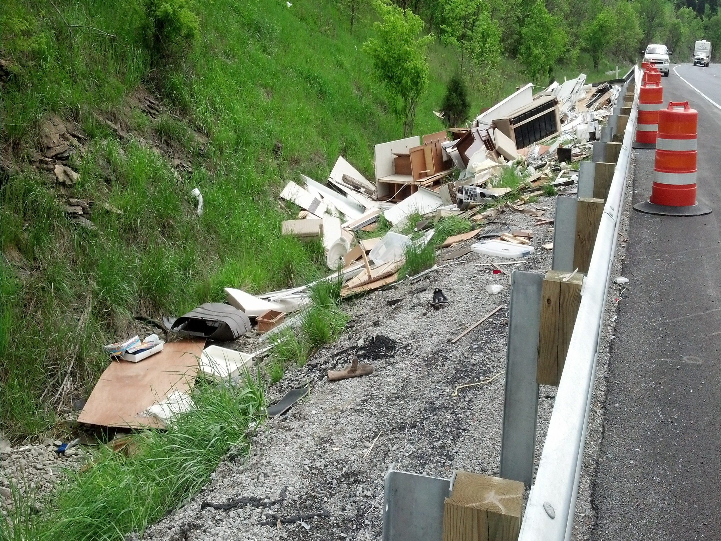

Slide 9
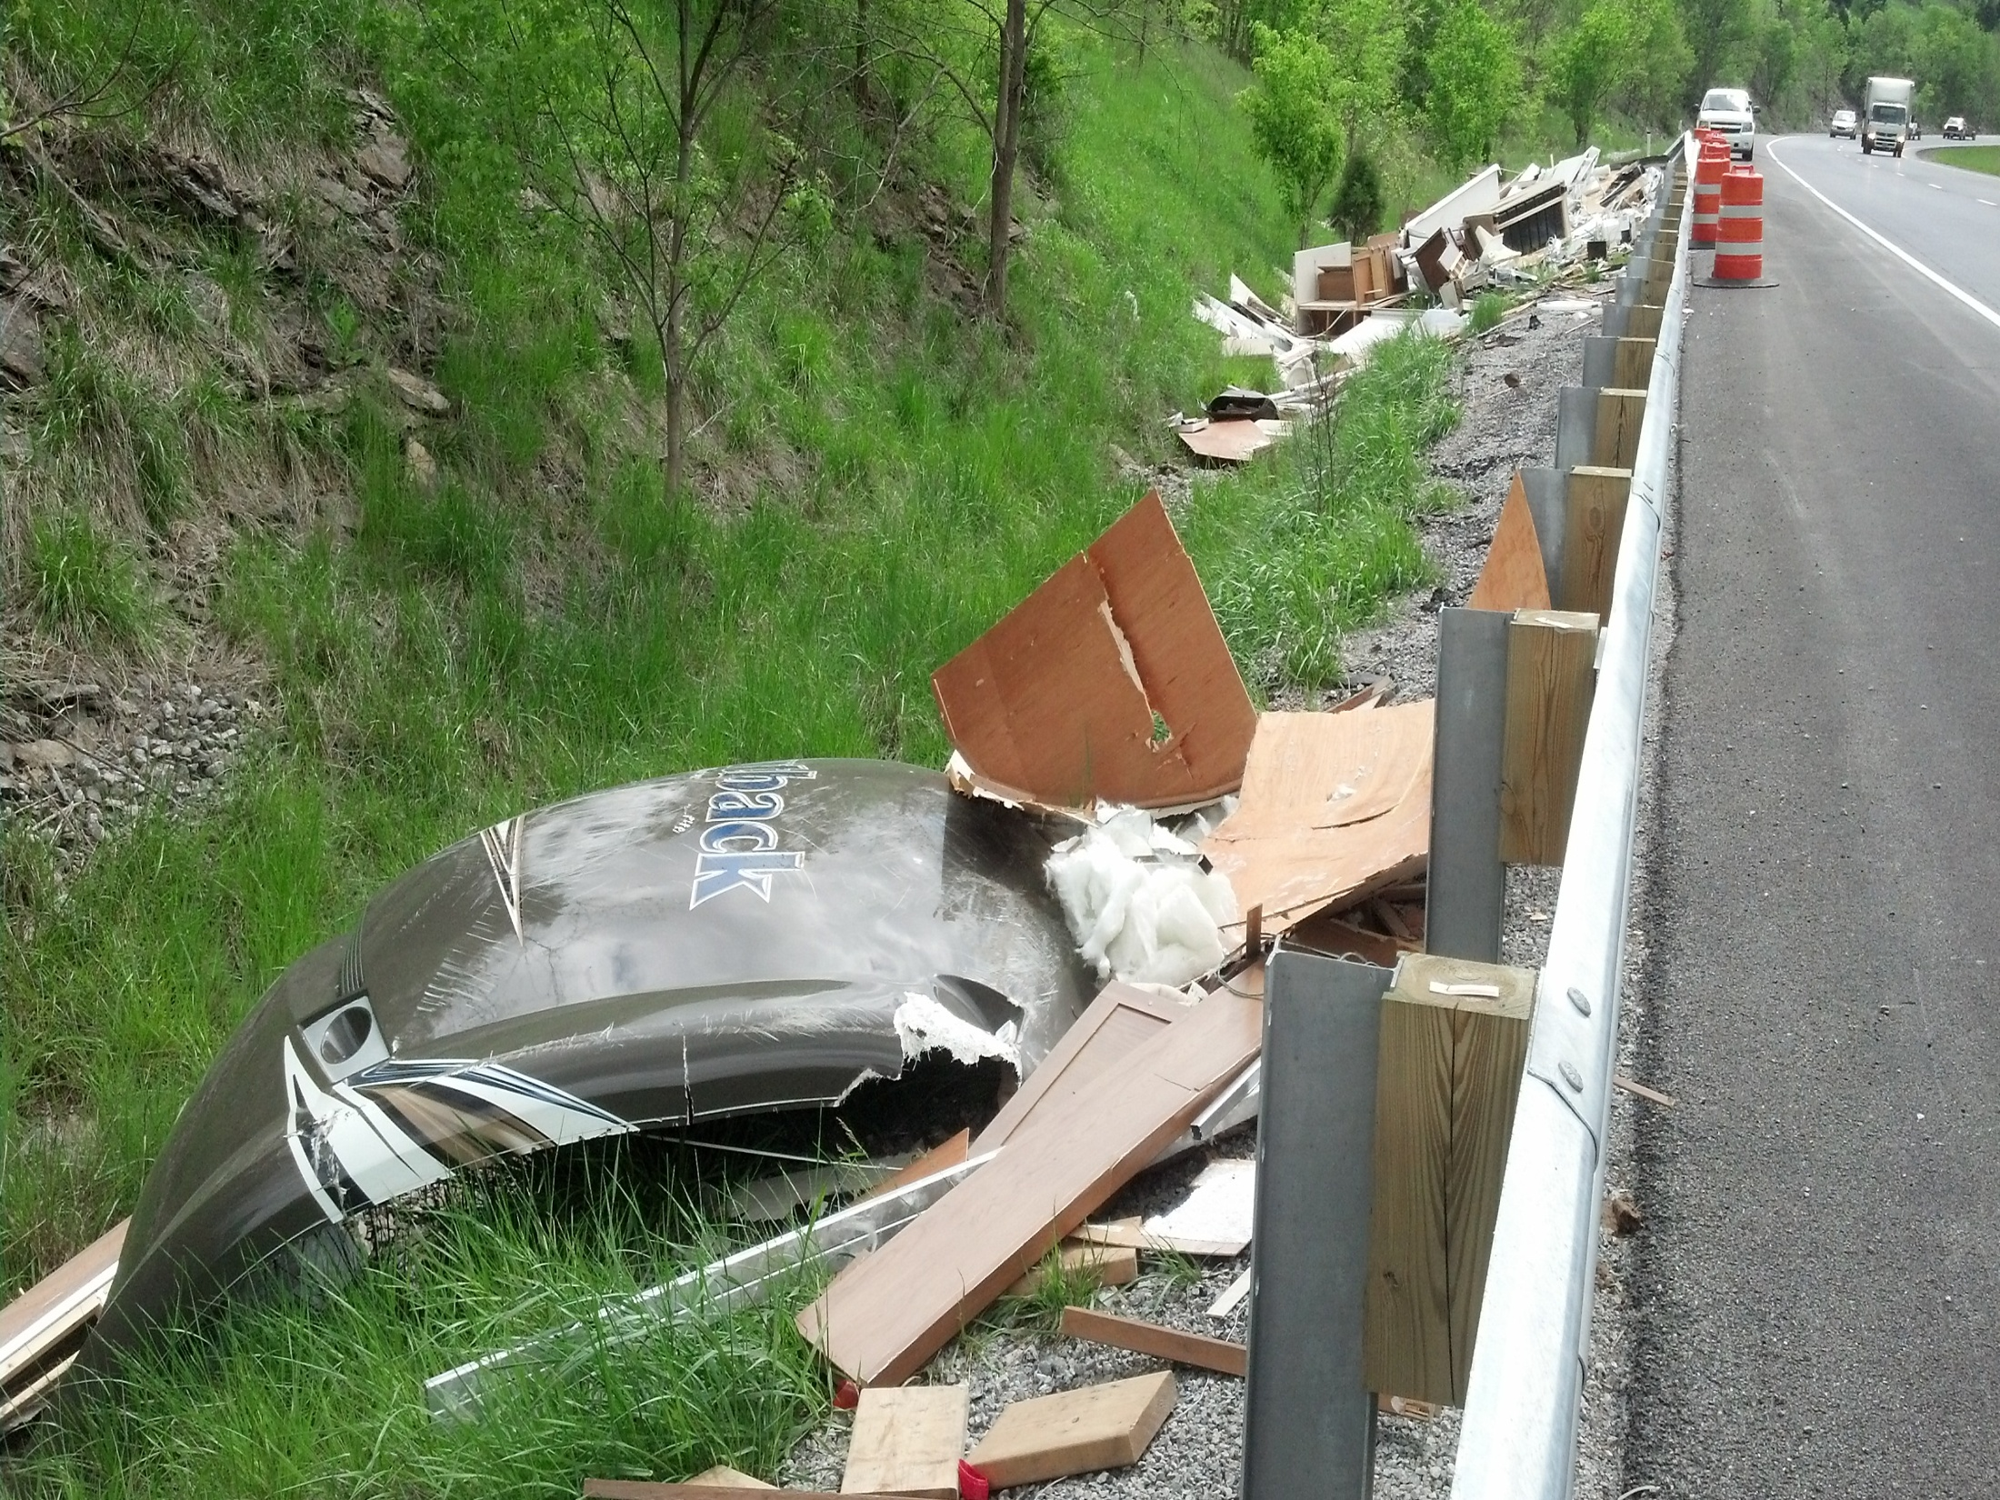

Slide 10
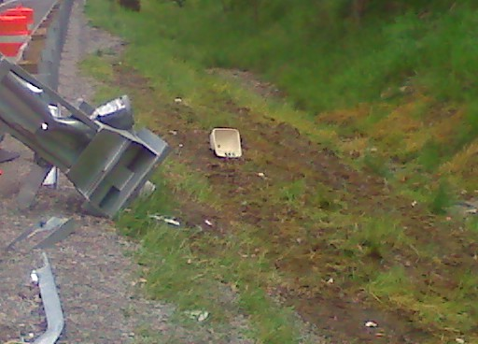

Slide 11
Incident Review
I-71 NB Two Semi Crash 5/15/13
Gallatin County MP 58.0

Slide 12
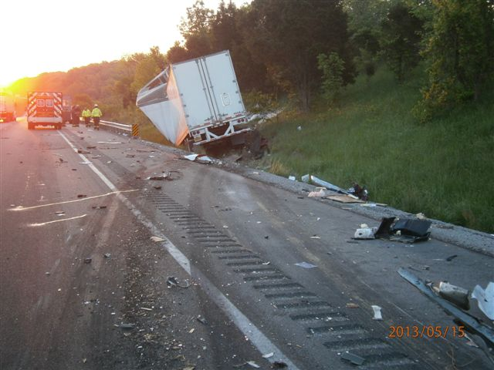

Slide 13
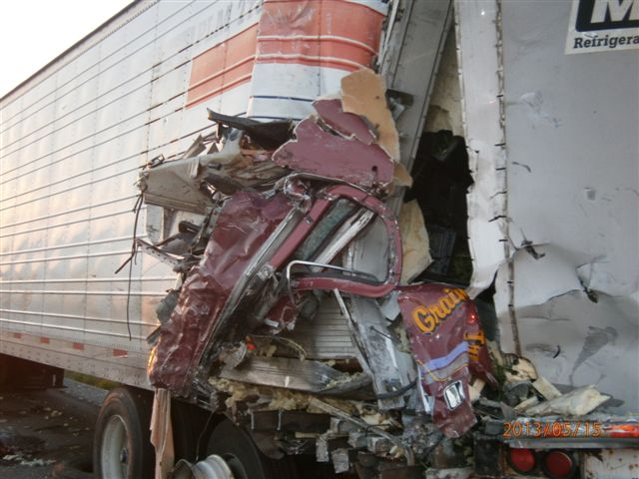

Slide 14
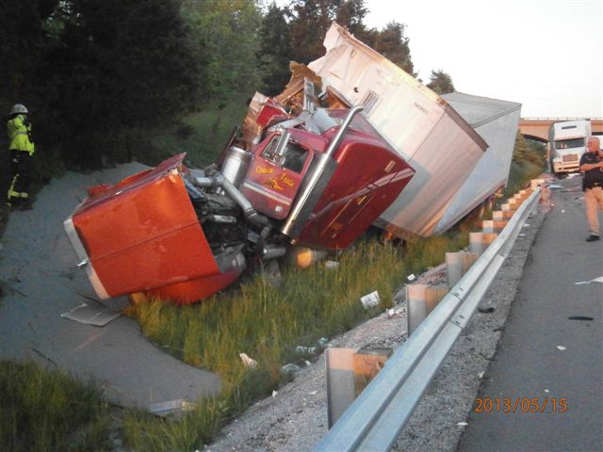

Slide 15
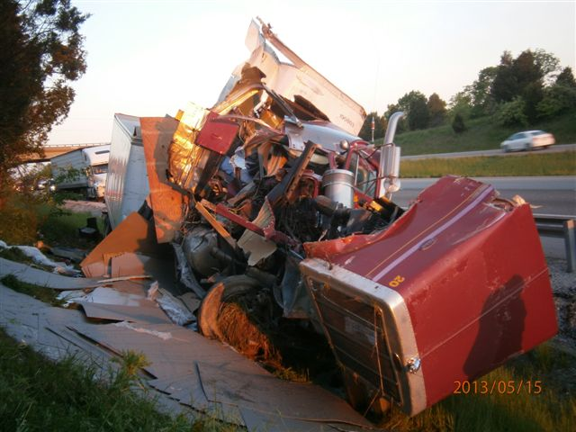

Slide 16
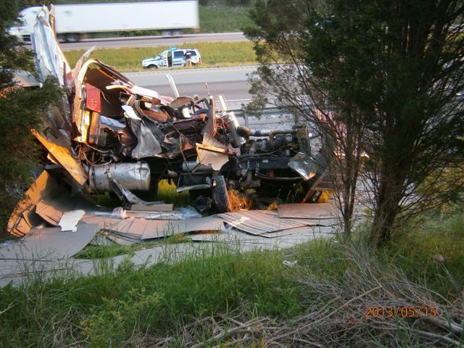

Slide 17
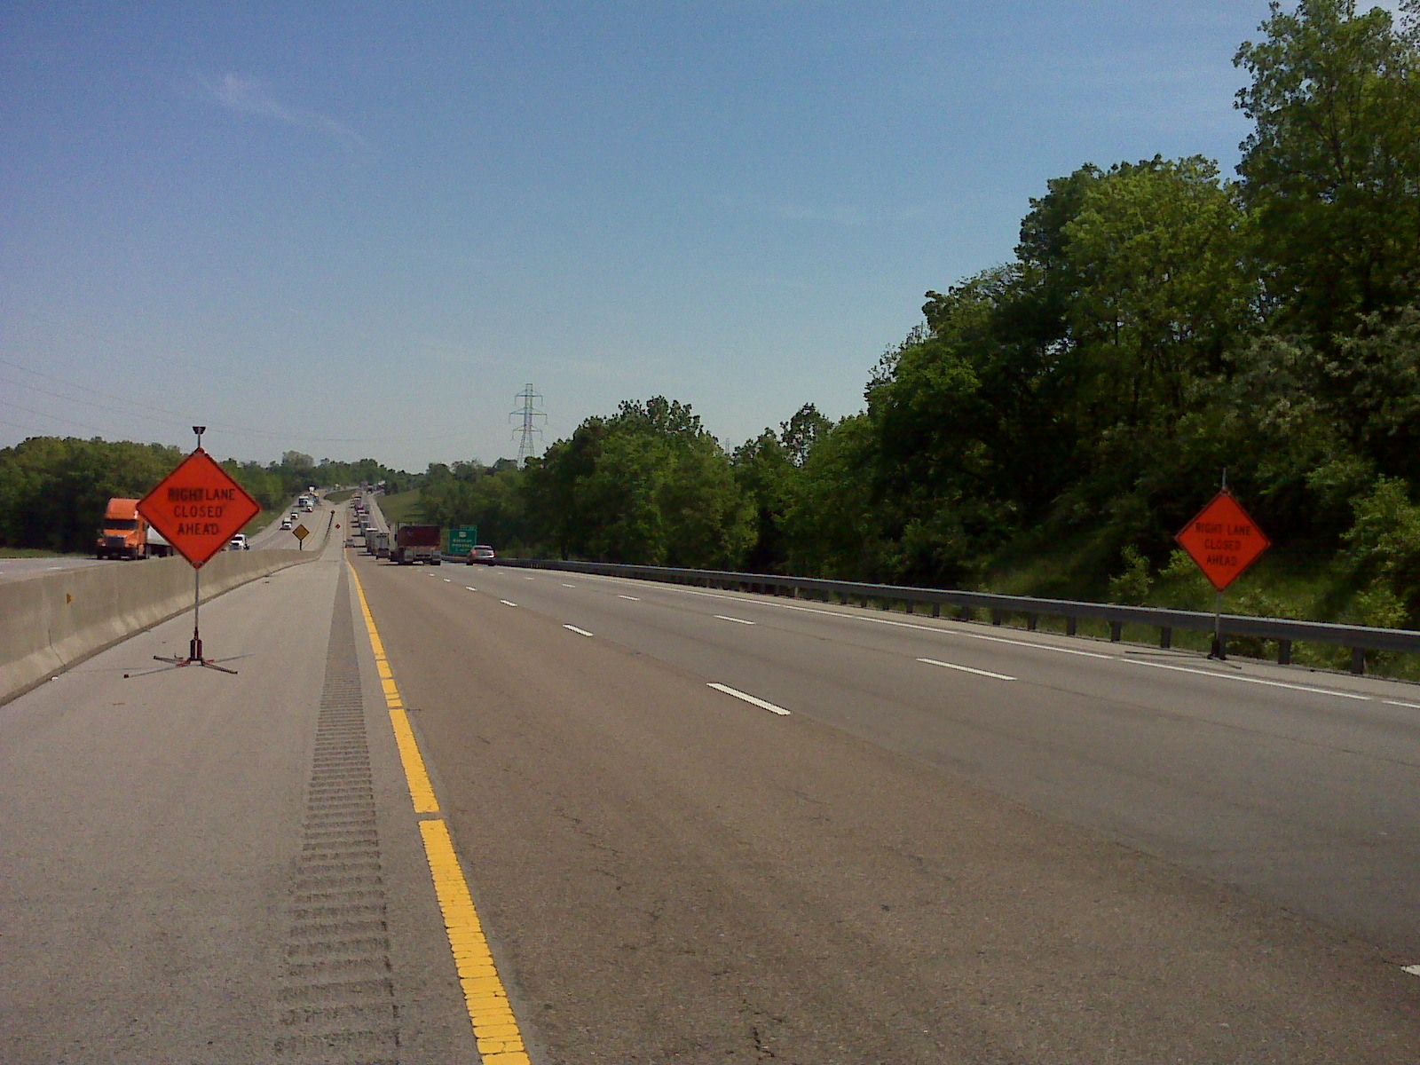

Slide 18
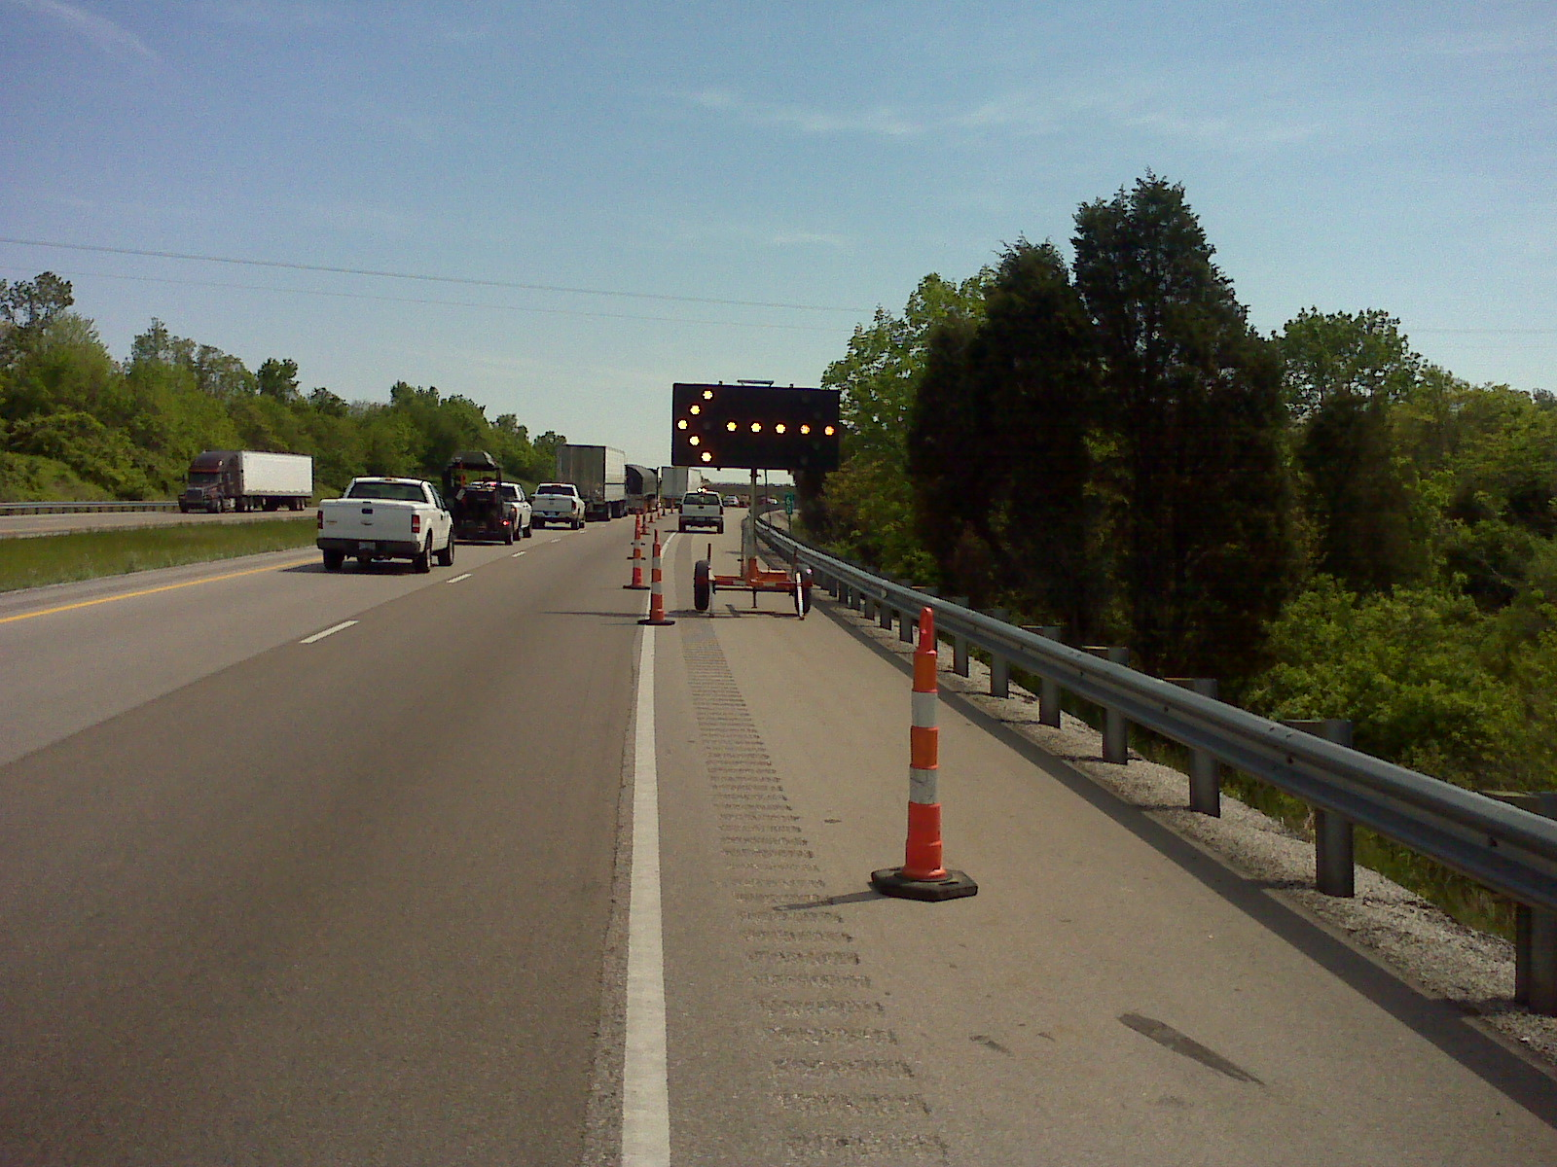

Slide 19
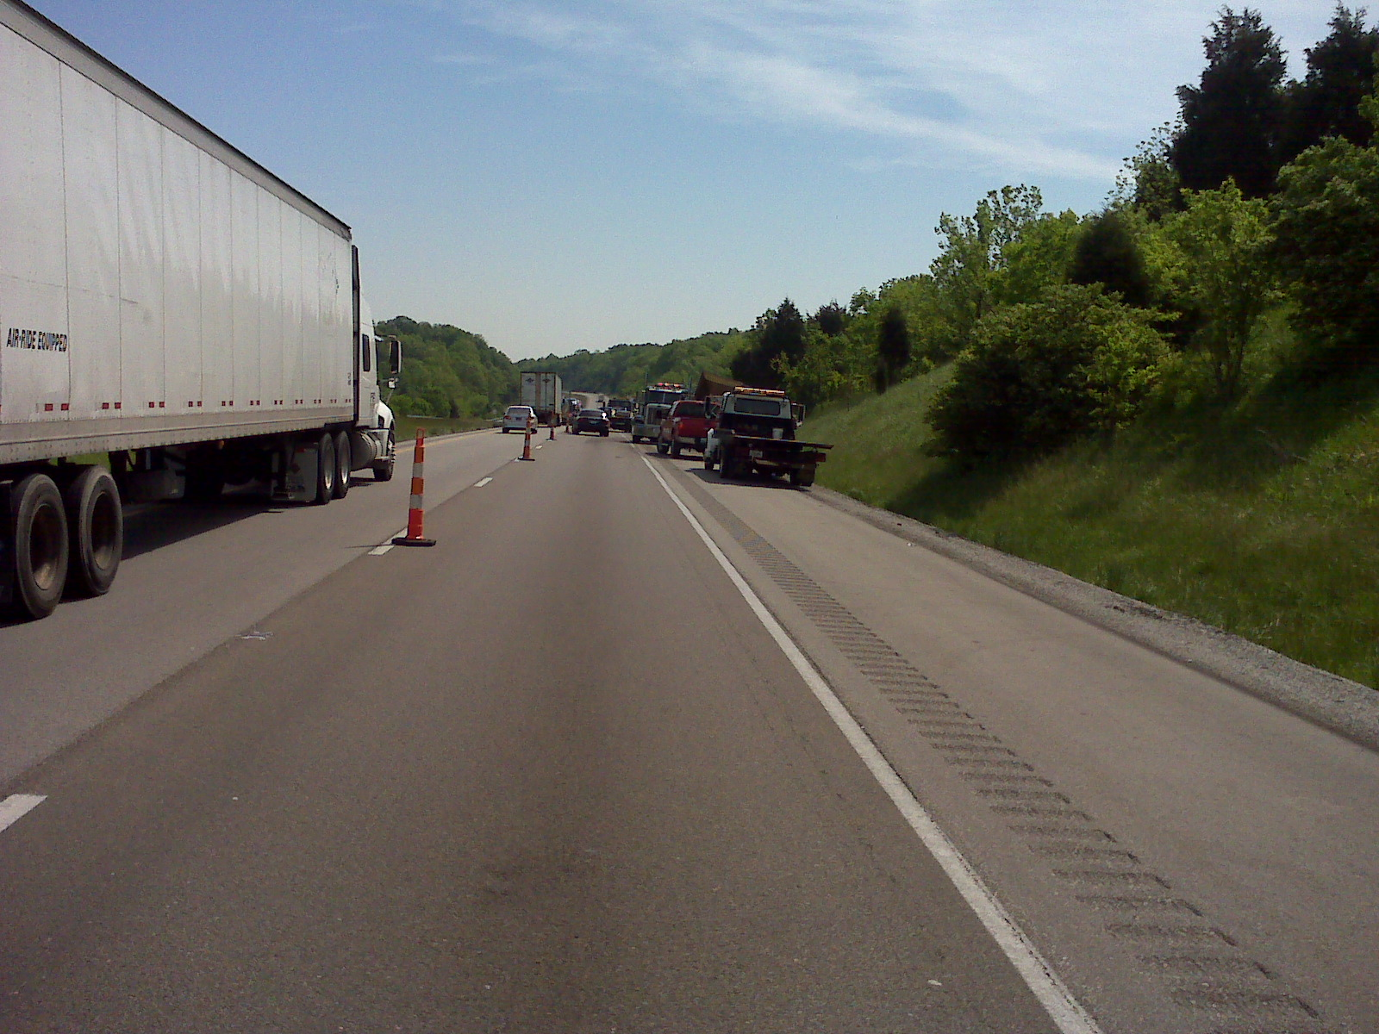

Slide 20
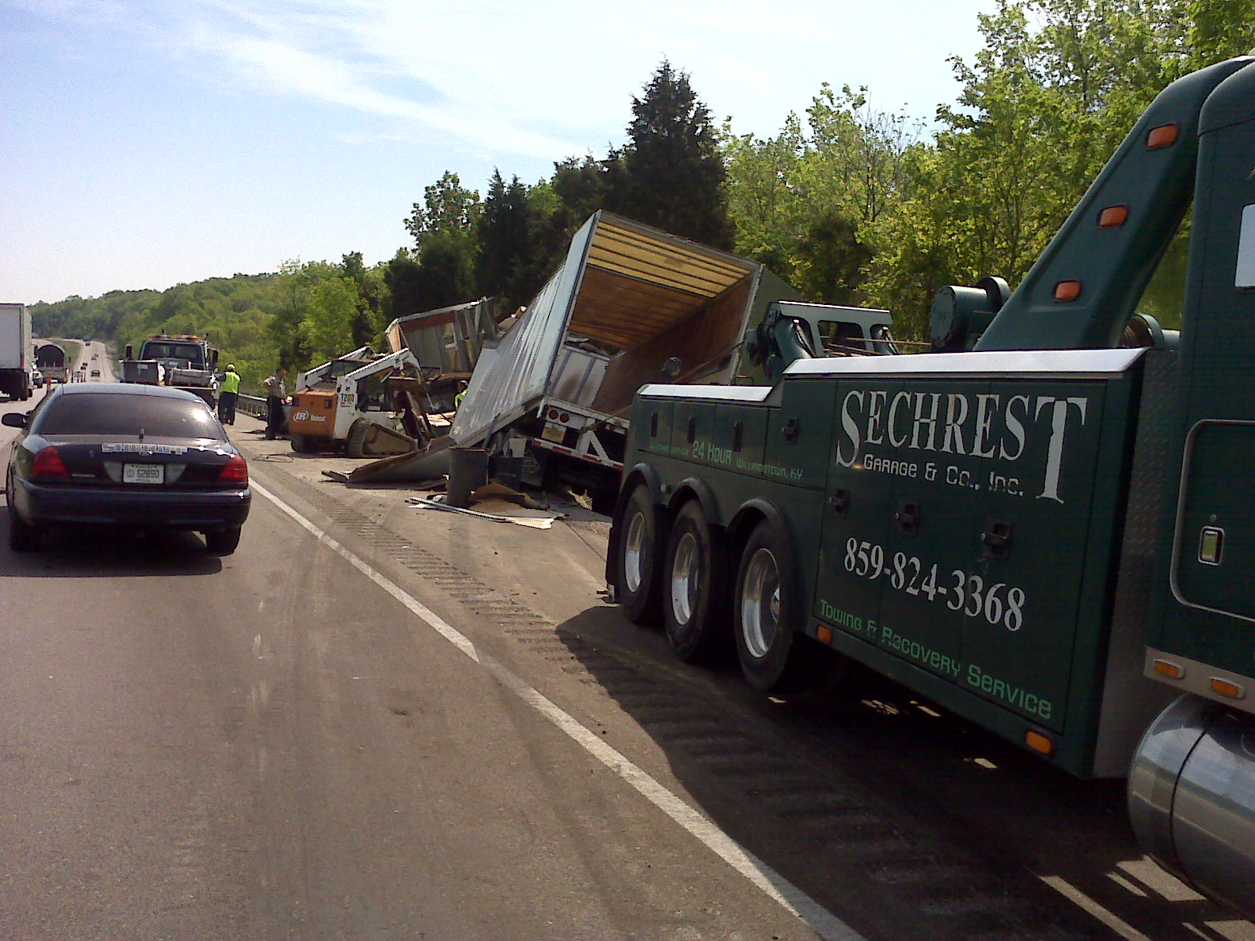

Slide 21
Incident Review
I-75 SB Semi Crash & Spill 6/20/13 Grant County MP 143.3

Slide 22
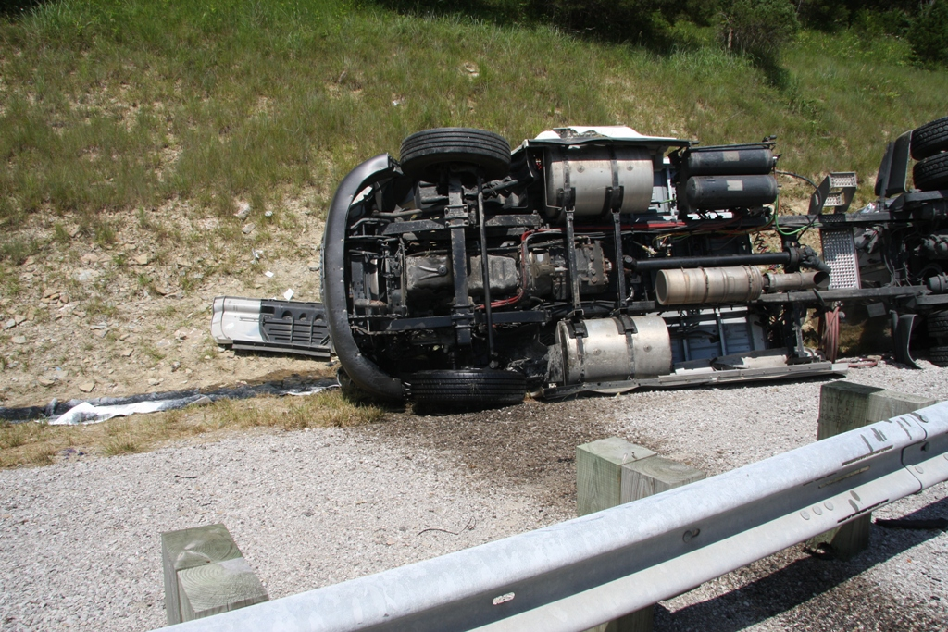

Slide 23
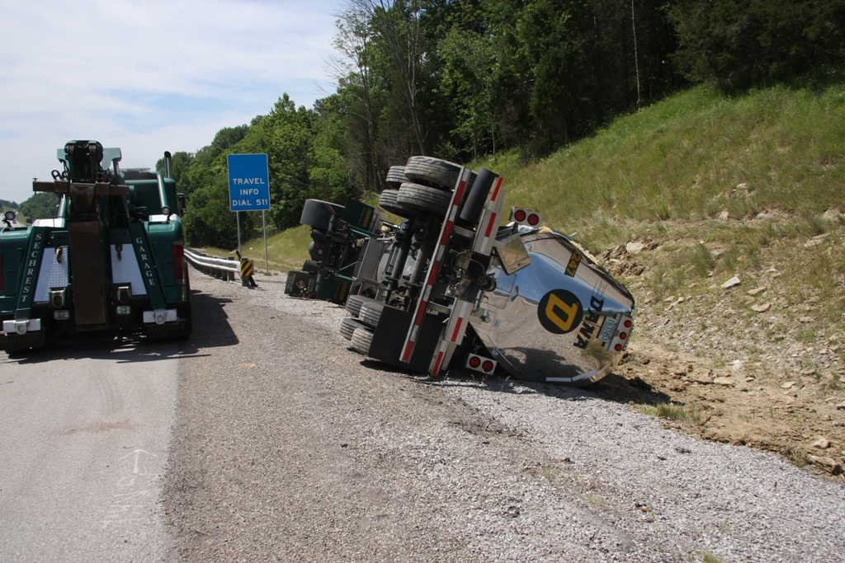

Slide 24
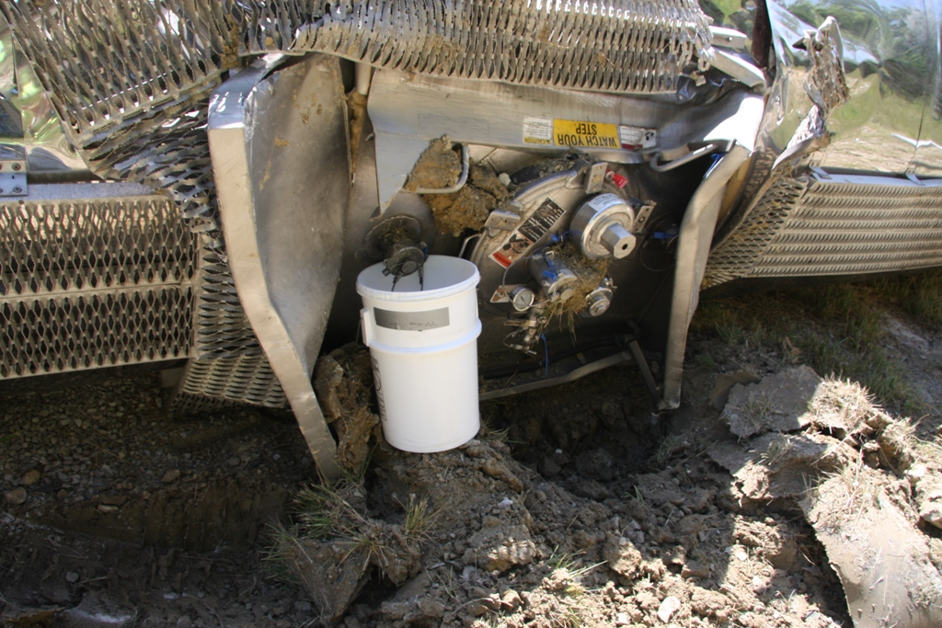

Slide 25
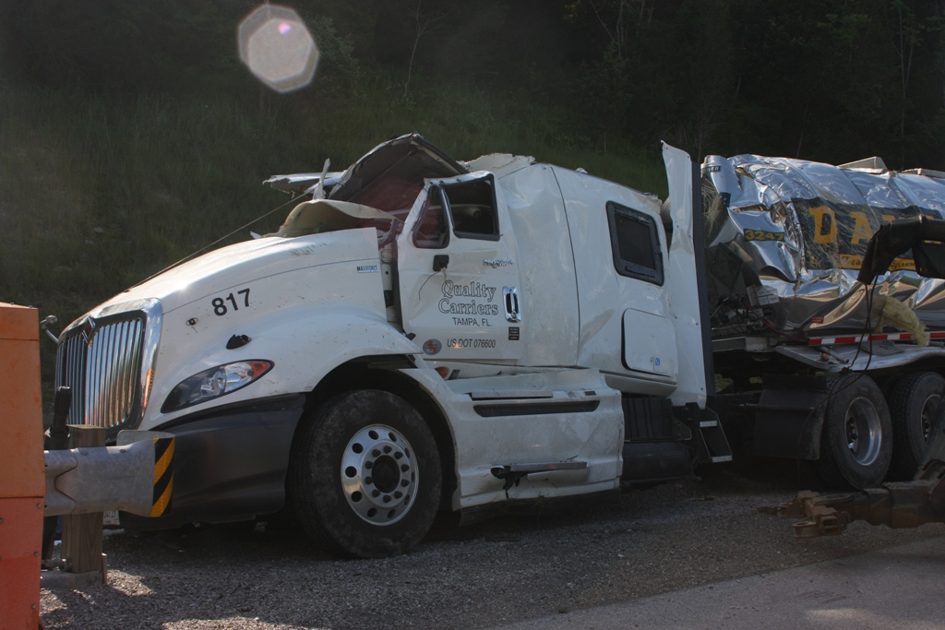

Slide 26
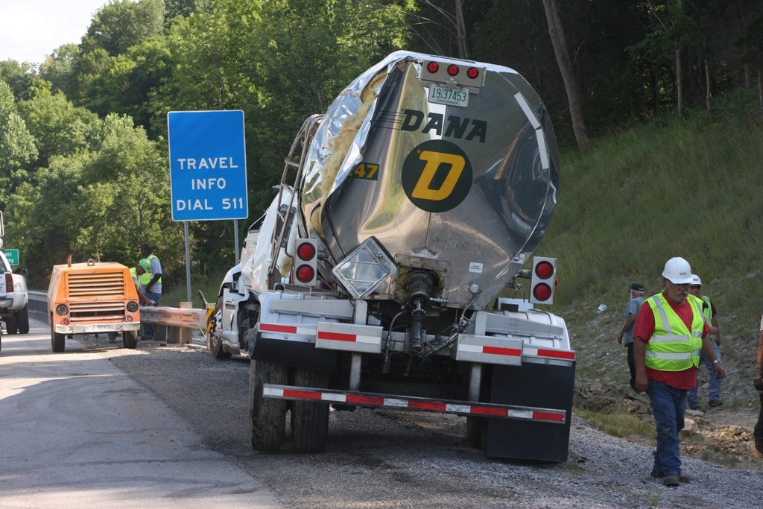

Slide 27
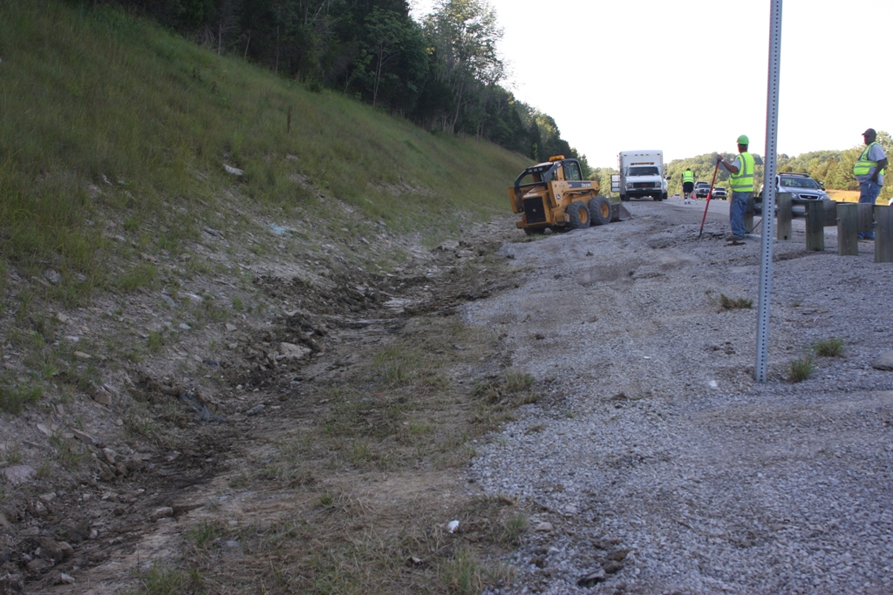

Slide 28
Crash Statistics
Quarterly Crash Statistics
KSP CRASH Database
Valerie Januski
District 6 Safety Officer

Slide 29
Southeast Counties

Slide 35
Southwest Counties

Slide 41
Construction Update

Slide 42
Other Business
Information Sharing

Slide 43
Upcoming Incident Management Training

Slide 44
Adjourn
Next Meeting
Tuesday October 8, 2013
1:00 PM

